Slide 1
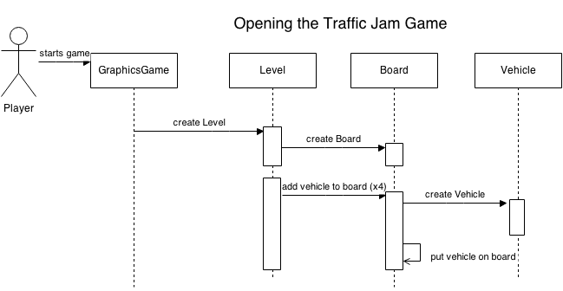
Sequence diagrams

Slide 2
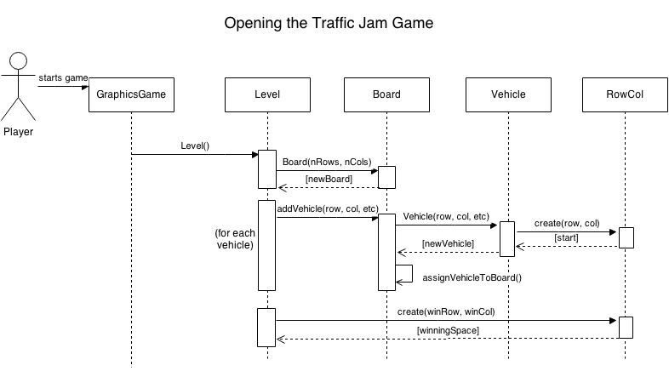
Sequence diagrams

